Slide 1
2014 Student Success Scorecard
PaRC Presentation
May 7, 2014
*Formerly known as the Accountability Reporting for Community Colleges (ARCC)
E. Kuo
FH IR&P

Slide 2
Overview
Annual scorecard with specific metrics related to student progress and success
Framework based on Student Success Taskforce (SSTF) recommendations
Disaggregation of data
Longitudinal data

Slide 3
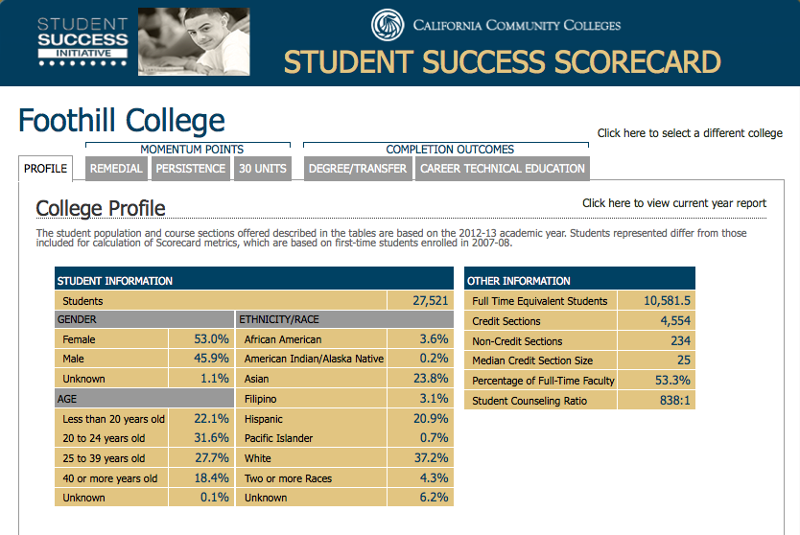
College Profile
FT Faculty based on district figures
Over half of 2012-13 students are younger than 25
New data element for 2014
Statewide: 719:1
Compared to 2011-12, increase of 6% among this group
Asians, Hispanics and Whites make up 82% of students enrolled
Notes:
Increase of about 2% among Asians, Hispanics and Whites from 2011-12 (mainly due to Hispanic increase)
% of full-time faculty drop by roughly 2% (55.5% in 2011-12)
Counseling FTEs (Counselor Assignment + Counseling Courses):
Work assignment FTEs are defined by Administrative and Support Activities (ASA) codes listed in the California Community Colleges Chancellor’s Office (CCCCO) Budget And Accounting Manual. Counseling assignment FTEs during the fall term of the reporting year are included for the following
ASA codes:
•6300 Student Counseling and Guidance
•6310 Counseling and Guidance
•6330 Transfer Programs
•6340 Career Guidance
•6390 Other Student Counseling and Guidance
The following two ASA codes are excluded:
•6420 Disabled Students Programs and Services(DSPS)
•6430 Extended Opportunities Programs and Services (EOPS)
Course Instruction in Counseling FTEs: When a faculty member instructs student development courses during the fall term of the reporting year the related FTEs are incorporated into the Student-Counseling Ratio. Instructional FTEs are comprised of the following Taxonomy of Program (TOP) codes:
•493010 Guidance
•493011 Interpersonal Skills
•493012 Job Seeking/Changing Skills
•493013 Academic Guidance

Slide 4
College Indicators
Scorecard focuses on 2007-08 cohort
Tracking students over six years
Data available for five cohorts
  2003-04 to 2007-08
Completion Outcomes
  Degree/Transfer
  Career Technical Education
Momentum Points
  Persistence
  30 Units
  Remedial (Math, English, ESL)

Slide 5
Completion
Definition: Percentage of degree, certificate and/or transfer-seeking students starting first time in 2007-08 tracked for six years through 2012-13 who completed a degree, certificate or transfer-related outcomes.
Foothill Prepared
State Prepared
Foothill Overall
State Overall
Foothill Unprepared
Prepared/Unprepared determined by lowest attempted Math or English course
State Unprepared
Overall Completion Rate by Ethnicity
40% African American (21/52)
62% Filipino (16/26)
38% Latino (57/149)
Compared to
85% Asian (223/263)
66% White (263/399)
Notes:
Prepared/Unprepared based on lowest attempted Math or English course.
If lowest attempted Math course was one below or college level, then student is “prepared for college.”
If lowest attempted English course was college level, then student is “prepared for college.”
If lowest attempted Math or English was below college level (two levels below or more in Math), then student is “unprepared for college.”
If student attempts both Math and English,if lowest of either is below college level, then student is “unprepared for college.”
Overall completion rates by ethnicity—Foothill higher than state rates

Slide 6
Completion Peer Grouping
Overall Completion Rates
Peer group high: 64%
Peer Group average: 56%
Peer Group low: 49%
Methodology: Using predictors BA/BS Index, weighted API, Pct Age 25+
Notes:
Group 7 peer group (out of 7 groups)
Predictors significant at .05 level
Adjusted R² = .68
Academic Performance Index based on CA DOE for each HS based on standardized test scores in a number of subjects
Bachelors of Arts/Sciences Index represents BA degree attainment of the population, age 25+in college’s service area. Index created by CCCCO, combines enrollment patterns (F07) based on residence zip codes from American Community Survey
Pct Age 25+ is percentage of students at the community college in F07 who are 25+ (from CCCCO MIS)

Slide 7
Persistence
Definition: Percentage of degree, certificate and/or transfer-seeking students starting first time in 2007-08 tracked for six years through 2012-13 who enrolled in the first four consecutive terms OR achieved degree/certificate/transfer outcome during same time period.
State Prepared
State Unprepared
Foothill Prepared
State Overall
Foothill Overall
Foothill Unprepared
Foothill reports slightly lower persistence rates when compared to state figures
Overall Persistence by Ethnicity
64% African American (33/52)
73% Filipino (19/26)
59% Latino (88/149)
Higher overall persistence rate by Latinos statewide (+10 percentage points)
Compared to
78% Asian (160/205)
69% White (275/399)

Slide 8
Attain 30 Units
Definition: Percentage of degree, certificate and/or transfer-seeking students starting first time in 2007-08 tracked for six years through 2012-13 who achieved at least 30 units.
Foothill Prepared
Foothill Overall
State Prepared
FH Unprepared
State Overall
State Unprepared
Foothill’s cohorts tend to attain 30 units at a higher rate
when compared to state figures
Higher overall attain 30 units rate by Latinos statewide (+4 percentage points)
Overall Attain 30 Units by Ethnicity
71% African American (37/52)
77% Filipino (20/26)
59% Latino (88/149)
Compared to
79% Asian (208/263)
74% White (295/399)
Higher overall attain 30 units rate by Foothill African Americans (+15 percentage points)

Slide 9
Who’s being counted?
Completion, Persistence and Attain 30 Units cohort:
  First-time new students (w/valid SSN)
  6 units minimum earned (pass course) within first three years
  Attempt any Math or English in first three years
Foothill 2007-08 cohort: 1,016 students
  455 Female (45%)
  857 Under age 20 (85%)
  399 Whites (39%)
  263 Asian (26%)
  149 Latino/a (15%)
  52 African Americans (5%)
Foothill had 1,541 new first-time students in 2007-08 academic year
Outcomes
Definitions
Notes:
First time new students:
F06: 1,298
W07: 417
S07: 339

Slide 10
Basic Skills Education Progress
Who’s in the cohort?
  Attempt a credit course below transfer level in 2007-08
What’s the cohort outcome?
  Math: pass a college-level Math course within 6 years (includes degree and transfer applicable)
  English: pass a college-level English course within 6 years
  ESL: pass the ESL sequence or a college-level English within 6 years
Notes:
Math cohort: attempt two to four levels before
English cohort: attempt one to four levels before
ESLL cohort: attempt of any ESLL below transfer
For each cohort exclude students concurrently enrolled at a four-year institution in the cohort year and the following academic year

Slide 11
Math
Cohort size decreased from a high of 918 students in 2003-04
FH Asian
FH Filipino
FH White
Foothill
FH Latino
FH African American
State
Who’s being counted at FH in 2007-08?
What’s being counted in 2007-08?
47 African Americans
20 Filipinos
Primarily Math 101 and Math My Way (230, 231, 235)
42 Asians
148 Latino/as
237 Whites
Total 564
African American rates increased by 4-percentage points from previous year cohort
Notes:
The total includes all races.
The data includes both Math classes that are degree applicable and not applicable.
Students with African American and White races both have shown a significant progress (4-5% point increase) in completing their Math classes in 2007-08 (55 African Americans and 233 Whites in 06-07)

Slide 12
English
What’s being counted at FH in 2007-08?
Primarily ENGL 100 and ENGL 110
FH Asian
FH White
FH Filipino
Foothill
FH Latino
State
FH African American
Who’s being counted at FH in 2007-08?
60 African Americans
Cohort size was decreasing from 940 in 2003-04 but increased by 8% from 2006-07
80 Asians
28 Pacific Islanders
Total 696
25 Filipinos
177 Latino/as
248 Whites
Notes:
The total includes all races.
The data includes both English classes that are degree applicable and not applicable.

Slide 13
ESLL
Who’s being counted at FH in 2007-08?
ESL cohort size continues to decrease from a high of 507 in 2003-04
<10 African American
59 White
0 Filipino & <10 PI
135 Asian
114 Latino/a
Total 336
FH Asian
Foothill
State
FH Latino/a
What’s being counted at FH in 2007-08?
Seems like about half in F07 are enrolled in ESL 166/167, 155/156, 136/137
Notes:
The total includes all races.
The data includes both ESL classes that are degree applicable and not applicable.

Slide 14
Career Technical Education
Definition: Percentage of students tracked for six years through 2012-13 who started first time in 2007-08 and completed more than eight units in courses classified as career technical education (or vocational) in a single discipline and completed a degree, certificate or transferred or achieved “transferred prepared” status.
253 Latino/as
12 Pacific Islanders
State
61 African Americans
Foothill
Who’s being counted at FH in 2007-08?
563 Asians
Total 1,981
63 Filipinos
835 Whites
Cohort size fairly consistent since 2003-04 (~2000)
CTE Cohort
Definition
Notes:
The total includes all races.
TOP code includes SAM B or C
Transferred Prepared=At least 60 transferrable CSU/UC units with minimum 2.0 GPA

Slide 15
What’s the message?
System-level:
  Emphasis on defining completion as degree/certificate and transfer attainment
  Different outcomes among Prepared and Unprepared students
Institution-level:
  Cohort size fluctuate but increased between 2006-07 to 2007-08
  Disaggregating data can lead to small groups of students
  Changes in courses (number and curriculum) affects what is included in the cohort
  How are we serving our students?
  Focusing on trends over time

Slide 16

What’s the next step?
How is this information useful to us?
  Institutional goals, objectives, metrics
  Focus on trends to promote outcomes among current students
What should be the institutional priorities in planning and resource allocation process
FOOTHILL COLLEGE

Slide 17
Check it out!
Student Success Scorecard
http://scorecard.cccco.edu
http://www.foothill.edu
FOOTHILL COLLEGE

Slide 18
What outcomes are counted?
Completion cohort outcomes definition:
  Earned AA/AS
  Earned Certificate
  Transfer to four-year institution
  At least 60 transferrable CSU/UC units with minimum 2.0 GPA
  Within 6 years
Need Updates?

Slide 19
What outcomes are counted?
Persistence cohort outcomes definition:
  Enroll in four consecutive quarters
  Within the first year of enrollment
  OR Earned AA/AS, Earned Certificate, Transfer to four-year institution within four consecutive quarters
Attain 30 Units cohort outcomes definition:
  Earned at least 30 units
  Within 6 years
Need Updates?
Basic Skills
“Remediation” Cohort

Slide 20
Who’s in the CTE cohort?
First-time CTE course completers who also complete 8+ units in the subsequent 3 years in a single vocational discipline
What’s the cohort outcome?
Earned AA/AS
Earned Certificate
Transfer to a 4-yr institution
  At least 60 transferrable CSU/UC units with minimum 2.0 GPA
Within 6 years
Need update?
<------
Scorecard Summary

