Slide 1
Creating a Research Project
Foothill College Honors Institute

Slide 2
What’s your question?
What are you curious about?
The question should be related to one of the courses you’re taking.
Depending on your discipline, your question is known as a thesis, hypothesis, or purpose
Examples:
  How are women depicted in the arts through the centuries?
  How have court cases involving people of color influenced educational practices in the U.S.?
  What are some factors that influence how well countries do on international exams?
Notes:
Depends on discipline
Thesis, hypothesis or purpose

Slide 3
Methodology - How do you find information?
You should have at least 5 different sources.
Keep your methodology method to 50 words or less.
Methodology will differ depending on your discipline.
For all disciplines:
  Keep track of your sources.
  Cite your references.
  Do not list your textbook or people such as your professor or librarian.
Notes:
Break down by discipline – different research methodologies

Slide 4
Arts & Humanities
List extra textbooks (not your class textbook) you used.
Discuss the specific analytical lens you used in your research.
Example:
I looked at a variety of plays, histories, and reports from these time periods, and examined how they depicted the psychological effects of crime. I also read literature that talked about presence of trauma suffered by people of the era. My focus is on expressed trauma versus implied trauma. [49 words]

Slide 5
Social and behavioral sciences
Include types of works consulted
If you conducted a survey or experiment, that should be mentioned.
Note: no experiments on live animals including human subjects should be done.
Example:
I will utilize the work of Robert Reich, Franklin D. Roosevelt and Karl Marx to analyze the current socio-economic situation. I will then suggest various scenarios that address socio-economic inequities in our society. My models are based on the actions of party leaders, peer-reviewed studies, and official assertions. [48 words]

Slide 6
Mathematics & sciences
Description of data collection & data analysis
  Discuss how you collected data and the lens you are analyzing the data
  Include where you collected data
Example:
We conducted comparative analyses by taking cultures from infected, rehabilitating, and healthy dogs, growing the cultures, and completing antibiotic-sensitivity tests. A scientific survey was conducted for a greater sample size. A psychobiological analysis of charting weight and sleeping patterns helped us determine the effects on their biology and behavior. [49 words]

Slide 7
Proposal Write-Up – What to include
A title
  Something eye-catching
  Examples:
  - Tracing the development of sexism through the historical discredit of female artists
  - The Weight of Her Heart: Wu Zetian in Perspective
Notes:
Break down the slide – give examples for each
Title – needs to be catchy
One sentence description – what goes into the program
Abstract -- example

Slide 8
One-sentence description
Examples:
Tracing the development of sexism through the historical discredit of female artists.
- An examination of historian bias regarding Wu Zetian, the concubine who became the sole female Emperor of China, and its effect on contemporary views of women in positions of power.

Slide 9
Abstract (150 words or less)
Summary of driving question & results.

Slide 10
Methodology – 50 words or less
Describes the process used in the research project

Slide 11
References
At least 5 references – choose the ones that most informed your research

Slide 12
So your proposal has been accepted, now what?
Poster Write-Up
What’s a poster?
  A poster is 36 inch x 48 inch and contains the information from the next question.
  The poster will be printed out by Foothill College (paid for by Equity funds).
What goes into the poster?
  Your research question
  Background information
  Hypothesis
  Methodology
  Results
  Conclusions
  Implications of your project
Notes:
Show an example.

Slide 13
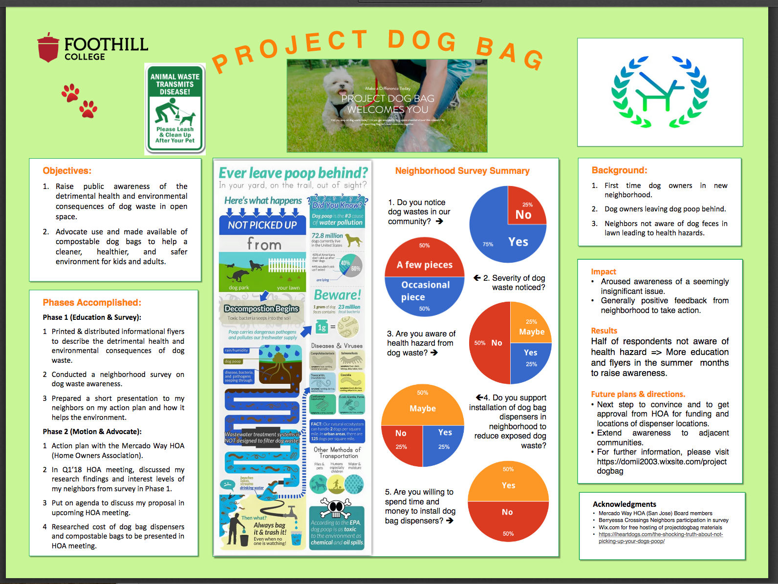

Slide 14
What’s a poster session?
You stand next to your poster with other presenters in a room.
You explain what your research project is about.
You answer questions people may have about your project.
A typical poster session lasts about 1.5 hours.

Slide 15
Poster Talk vs Poster Session
A poster talk focuses on just one research project at a time.
Your poster may be given special time for presentation.
The talk should include:
  Research question
  Background information
  Methodology
  Results
  Conclusions & Implications of your project
Your presentation should be high-quality & polished.
  The Honors co-directors will set aside time for you to give a mock presentation.

Slide 16
Sources of help
Faculty Mentor – ask a faculty member to go over your work
Honors Co-directors – they can answer general questions you may have about the research symposium and research projects.
(Specific questions should be directed to your faculty mentor.)

Slide 17
Helpful websites
For information on the Bay Honors Research Symposium
  http://www.bayhonors.org/symposium/presenting
For information on the Foothill College Research & Service Leadership Symposium
  https://foothill.edu/rsl-symposium/

