Slide 1
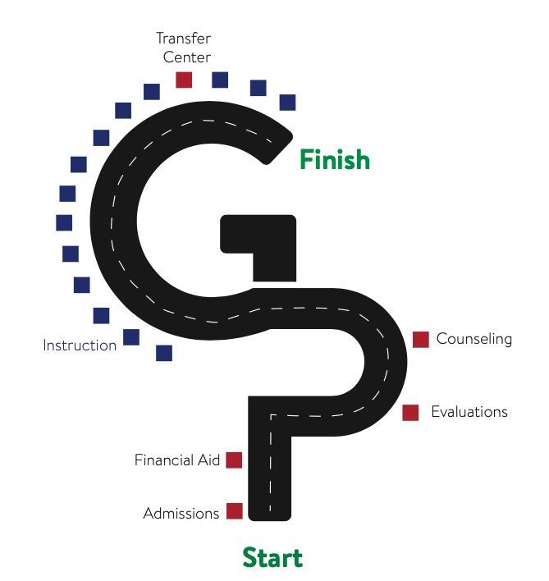

Test drive our current enrollment process
Onboarding Leads
Hilda Fernandez
Dokesha Meacham
March 8, 2021
Notes:
Hilda : Our goal is to make the campus student-ready instead of making the students college ready.
Dokesha: So why onboarding?

Slide 2

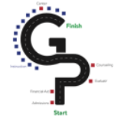

1st Contact w/ campus to completion of 1st college course.
Connection
Outreach, Application, Admissions, Financial aid app
Entry
Orientation, Financial Aid support, Dual Enrollment Partnerships, Major Exploration, Tutoring
Diagnostic Assessment Tools, Career Exploration, Intrusive Counseling, Support Services
Objective: Consolidate the onboarding processes by identifying and removing barriers and replicating processes that facilitate student success
Notes:
Hilda shares this info.

Slide 3
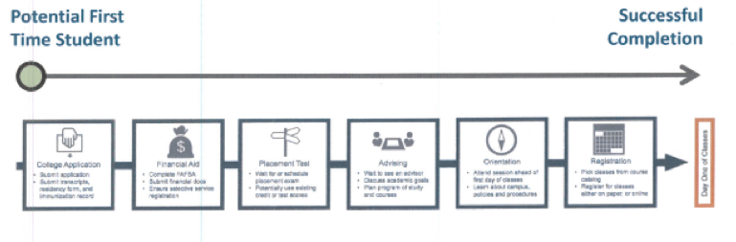

What we think it looks like

Slide 4

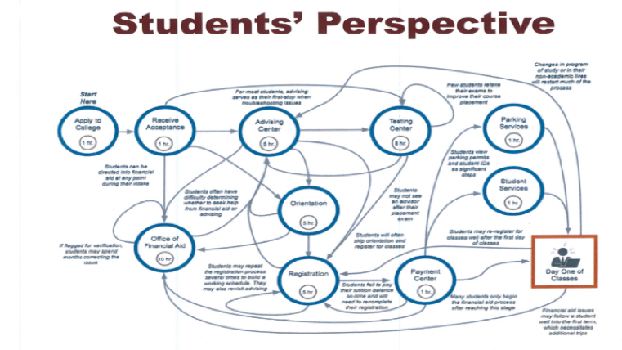
What it looks like

Slide 5

What we've been up to...
Connection
Research other campus GP Onboarding work and best practices
Outreach Connection
Virtual workshops
Ask Outreach Sessions
Meeting w/ outreach throughout term
Welcome Email
Meetings with ETS & A&R
Testing in Process by ETS
Reviewing emails from other CCC's
Entry
Orientation
Focus Group & Data Dump
Onboarding course content creation and collaboration
Welcome Webpage
Review of CCC onboarding sites
2nd Mtg w/ Marketing 3/16
Individual Program Check-in
FEI, Adult Ed, Fin Aid, A&R, Assessment
Survey of programs w/ data & tech team

Slide 6

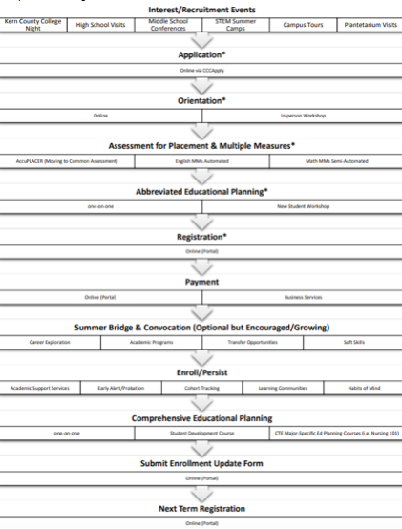

Major Takeaways
How we think the onboarding process works and how students experience the process does not align.
Students describe gaps in communication: lots of info online, yet necessary info to get started is not student facing.
Students want to be part of a community immediately and need to connect to programs and services to do so.
Students feel lost after completing the application since they are not provided directions beyond the payment mark.
Students need multilingual information posted online.

Slide 7


Looking Forward
Goals: complete by the end of spring quarter (2021)
Orientation (1st draft): May-June
Welcome Email: June
Welcome Webpage: June
Notes:
Hilda shares this info.

