Slide 1
Foothill College Governance Redesign Update
May 24, 2018

Slide 2
Governance Redesign Timeline
PaRC May 16 and June 6
Governance Summit Sept 14
Spring
Finalize Proposal
Fall 2018
Implement at Governance Summit
Facilitator Training
Governance Redesign Town Hall May 24

Slide 3
Governance Change Timeline
2015
Ed Master Plan goal on Governance
Spring 2016 Governance Structure Survey Discussions
Fall 2016 Accreditation Summit led to Quality Focused Essay Topic on Governance
Sept 2017 Governance Retreat discussed need for new system
2017-18 Governance Redesign Leadership Council recommends to PaRC

Slide 4
Leadership Council on Governance Redesign
Classified Staff:
Erin Ortiz‎; Craig Gawlick‎; Anthony Cervantes‎; Denise Perez‎
Students:
Danya Adib; Chinwe Idika; Eoin O'Farrell‎‎; Marcel Vermeer
Fulltime Faculty:
Isaac Escoto; Amy Edwards‎
Parttime Faculty:
Brendan Mar; Katherine Schaefers
Administrators:
Laureen Balducci‎; Paul Starer‎;

Slide 5
2017-18 Meetings
Governance Summit Sept 14
Leadership Council
Nov 6, Nov 20, Jan 12, Jan 24, Feb 26, Mar 14, May 1, May 9
PaRC Discussions
Oct 11, Jan 17, Feb 21, March 7, May 16, June 6
Town Hall -- Feb 28, May 24

Slide 6
Feedback from Council Feb 26 and Town Hall Feb 28
The equity / education committee appears to have a lot of topics for one committee.
Within Ed Master Plan idea – maybe 3 or 4 committees is not enough.
All committees should consider the review of strategic resource allocations (not just the Council).
Align passions to serve on a smaller committee – provide opportunities for engagement that might be narrower in focus. Perhaps the idea of a “caucus” for particular focus areas?
What is the role of the facilitator?
I feel that there is not enough faculty members on the committee. Too many administrators.
I think this plan is a great 1st step and understand we have to be open to continued improvement.

Slide 7
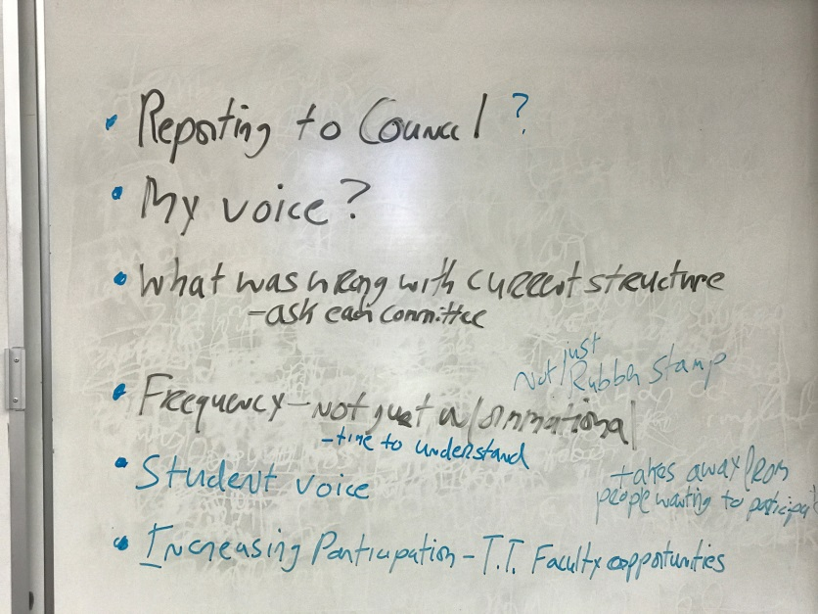
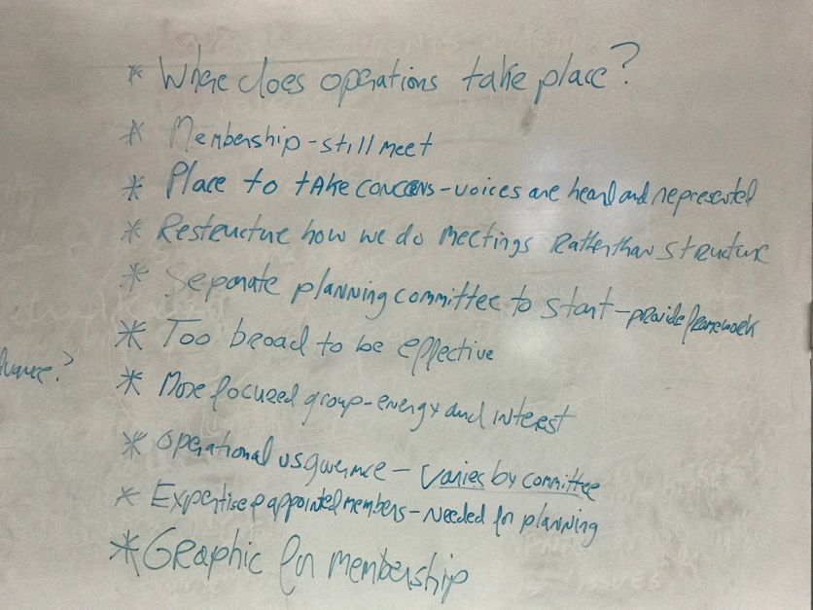
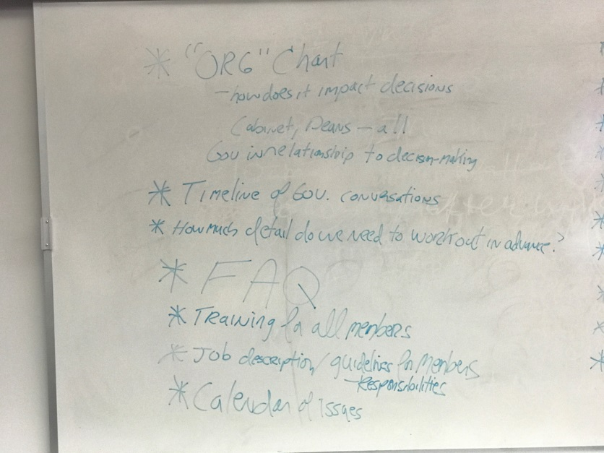
PaRC Feeback March 7

Slide 8
Changes / Clarifications
It will be up to the Senates (Academic, Classified, AFSC) and the President (for administrators) to make decisions on appointments to the committees, including terms and term limits.
Facilitators and recorders will be Foothill employees but not members of the committee (they will not vote, they will not be a tri-chair). They will be appointed by the president and assigned to a committee for a whole year
Committees will be able to appoint one or more study groups.
Each committee is independent and has a distinct membership. Each committee can make recommendations directly to the president.
Committee meetings will be scheduled for Friday afternoons. Committees can decide if they want to meet more than once monthly.
20 Frequently Asked Questions (FAQs)

Slide 9
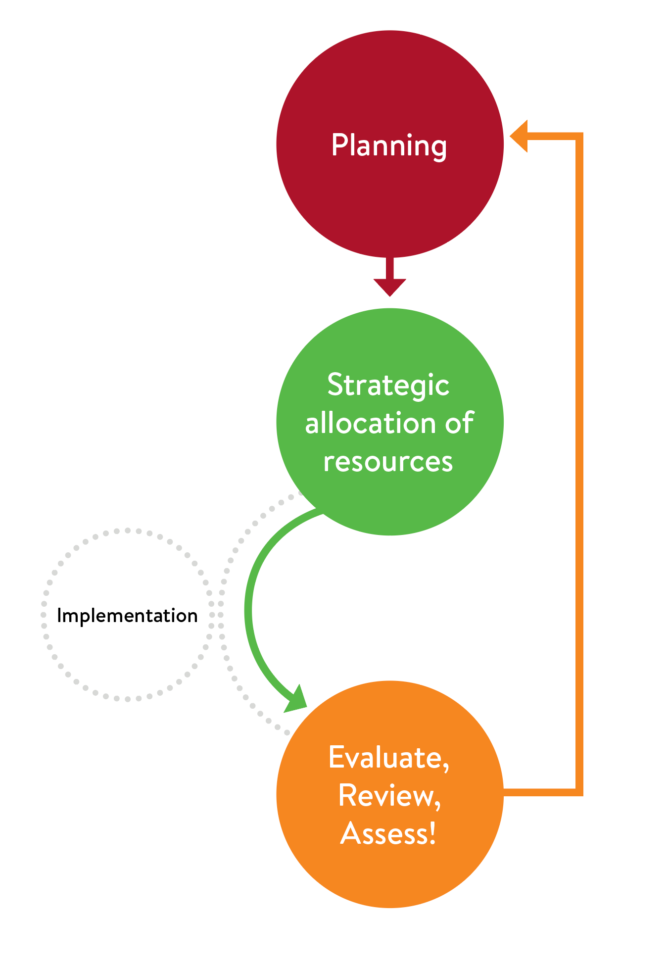
The Role of Governance (Draft)

Slide 10
Educational Master Plan Governance Model (Draft)

Slide 11
Strategic Decision Making Model (Draft)

Slide 12
Key Items of Discussion
Proposal for Program Review in 2018-19
Committee Membership
Committee Names
Faculty Prioritization

Slide 13
Questions / Suggests ?

Slide 14
From the Handbook …
Additional Background Slides Follow

Slide 15
Governance Committee Topic Areas
College Advisory Council on Educational Excellence
Strategic Objectives, college-wide planning, college resource allocation, prioritization of new full-time faculty hires (all funds), accreditation, program approval and discontinuance
Equity and Education
Instruction, equity, basic skills, program Review, 3SP, workforce, transfer, assessment, online enrollment, dual enrollment
Community and Communication
Professional development, community education, service leadership, institutional learning outcomes, alumni, governance, communication
Revenue and Resources
Budget, technology, sustainability, facilities

Slide 16
Proposal for Program Review in 2018-19
Each committee will redesign the program review process based on the areas under its charge and propose suggestions for the next year. The Council will review the proposals for consistency and recommend any needed changes back to the committees.
The program review process will use self-guided questions in 2018-19 to help inform program review re-design.
The Equity and Education committee will review out-of-cycle programs reviews from 2017-18. Identification of programs for discontinuance will be reviewed by the Council which will make a final recommendation to the President.

Slide 17
Operation of Committees
Each committee will have 12 members – 4 Faculty, 3 Classified Staff, 3 Students, and 2 Administrators. Members will be on only one committee.
Each committee will be assigned a recorder.
Each committee will be assigned ex-officio members to support the work of the committee.
Recommendations from the committees must be transmitted in written memorandum. The President will write back to the committee outlining the decisions made.
Committees will have a trained facilitator assigned by the President who is a Foothill employee but not a member.
Each of the 4 committees would meet on the same Friday of the month (e.g. Community Committee would meet on the first Friday of the month).

Slide 18
Proposed Study Groups
Committees may appoint members to one or more study groups that will meet for a defined period of time and present their findings and recommendations to the committee.
The study group will be chaired by a member of the educational master plan committee.
The study group could be made up of some of the members of the committee or the committee could appoint an entirely different group of members from the Foothill community.
Where possible, study groups will be announced at the September Governance Summit.

