Slide 1
Enrollment and Equity (E² ): A Focus on Retention
In-reach Efforts
GE Fridays
Apprenticeship
The Hoot
AB 540 scholarship
Non-credit ESL
First-gen website: foothill.edu/the first
Social media
Retention of online students between class start and census

Slide 2

Enrollment and Equity (E² ): A Focus on Retention
Outreach Efforts
Special Heights edition
Focus on our shopper/droppers
Message to HS counselors
Message to ActiveMatch students
ESL/Sunnyvale mailings
Social media ads
VTA ads
Suggestions?

Slide 3
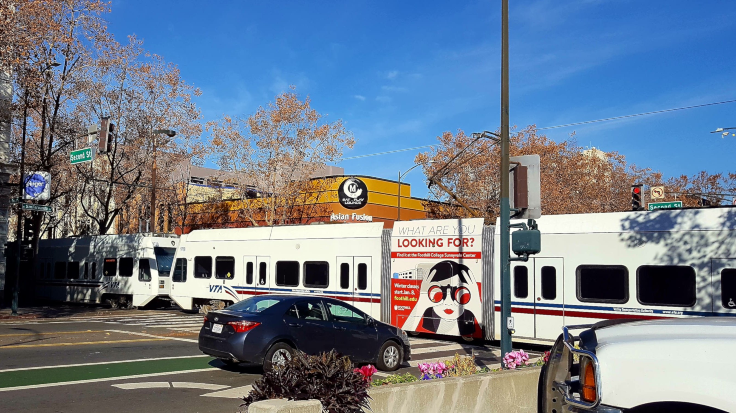
VTA Light Rail Sunnyvale Ad: Sunnyvale enrollment has improved over fall from -28% to -14

Slide 4




Slide 5

